Slide 1
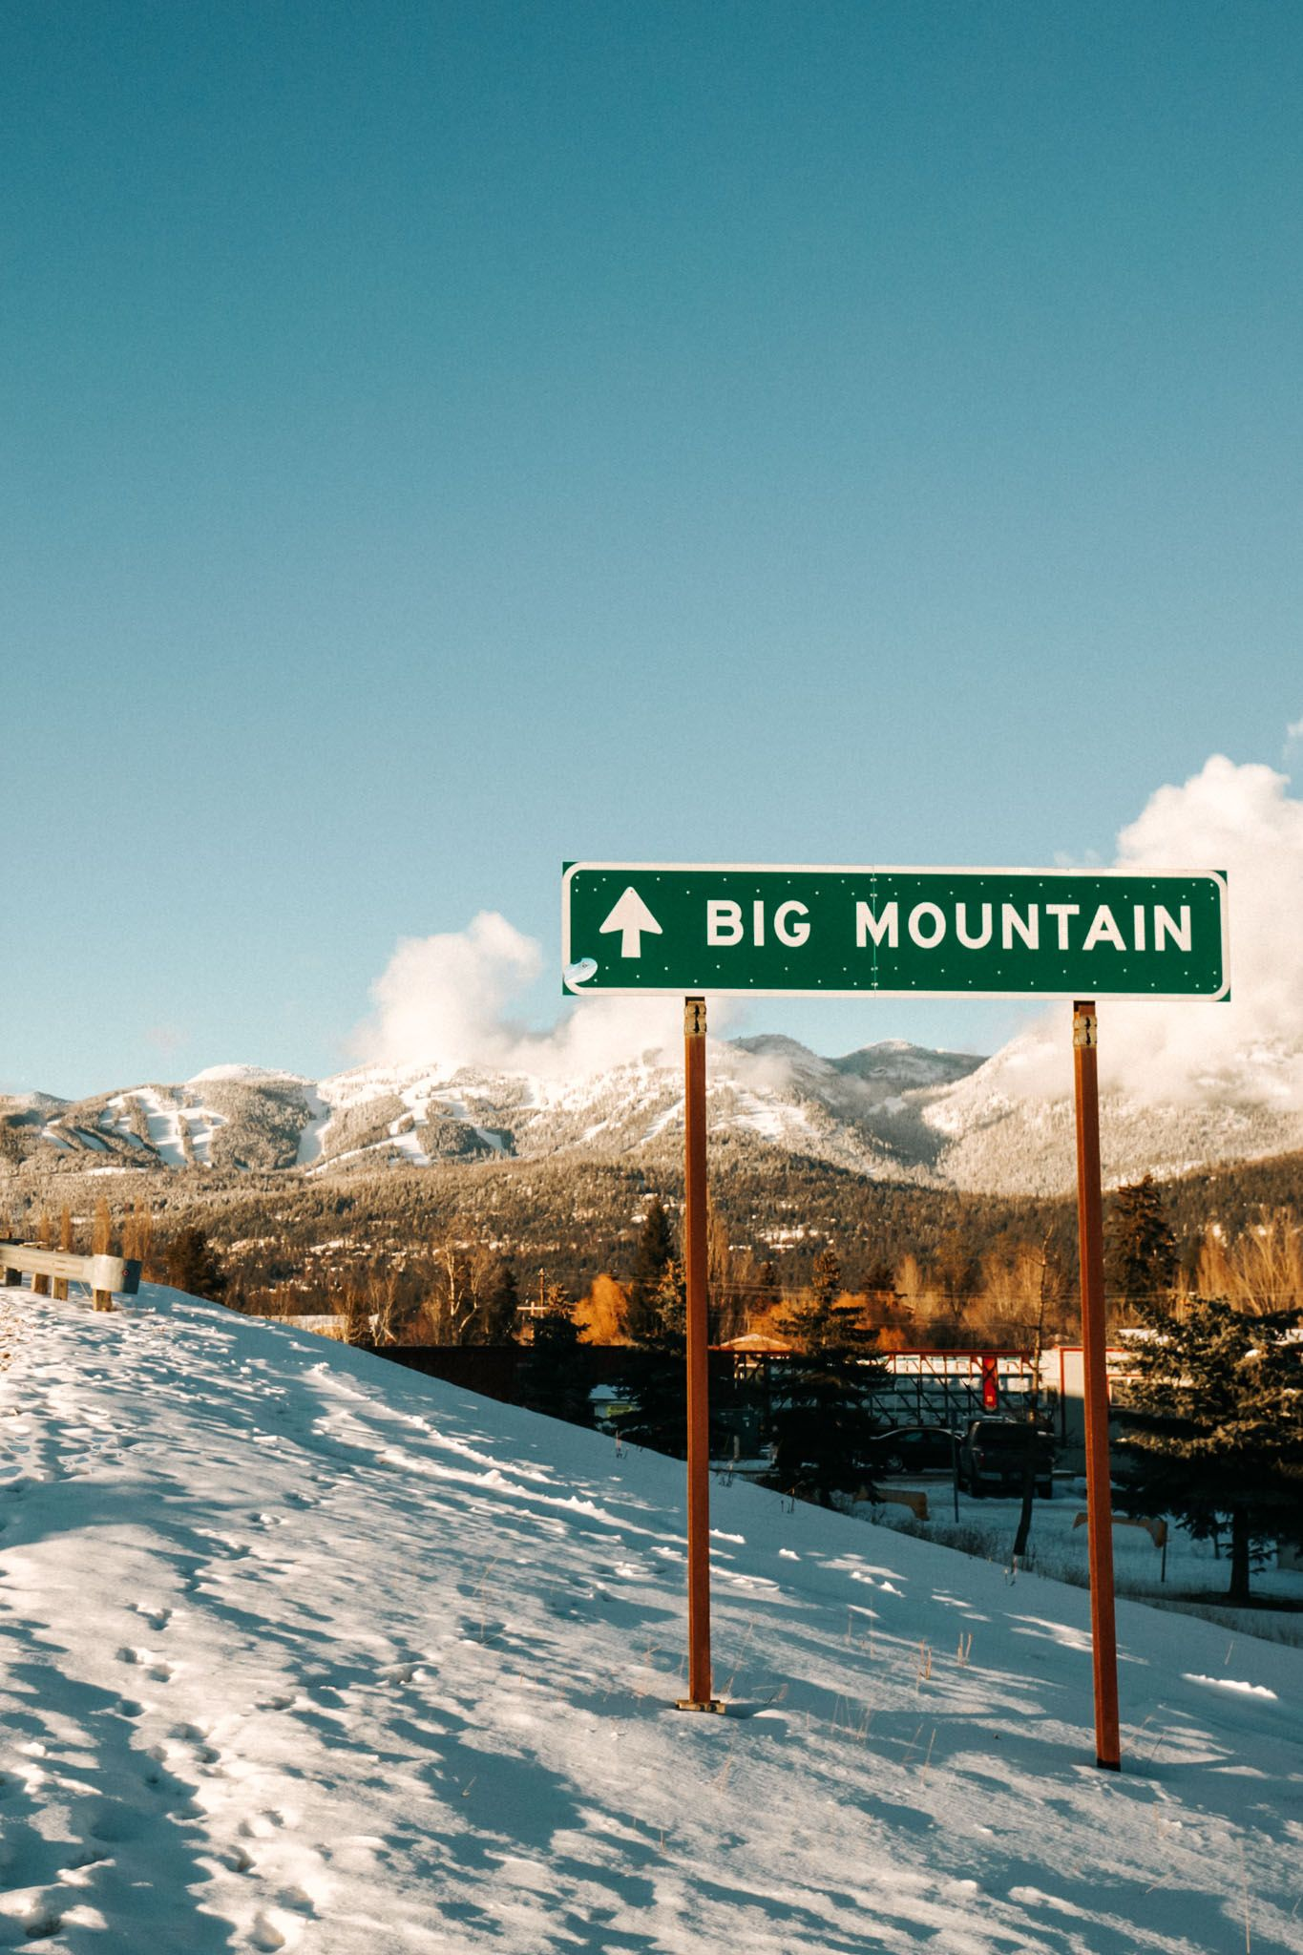
Big Mountain Resort
Guided Capstone

Slide 2
Problem Identification
The new chair lift Big Mountain Resort has recently installed increases their operating costs by $1,540,000 this season.
Through this project we investigated what options does Big Mountain Resort has to recoup this cost.
We focused on building a model to predict the adult weekend price for Big Mountain Resort based on the given resort characteristics.

Slide 3
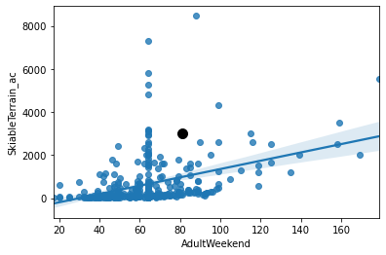
Recommendation
Big Mountain Resort (the black dot) has one of the largest skiable area among all the resorts, but its adult weekend ticket price is relatively low.
Our recommendation:
Raise adult weekend price from $81 to $96.
Expected increase in revenue:
$4,500,000

Slide 4
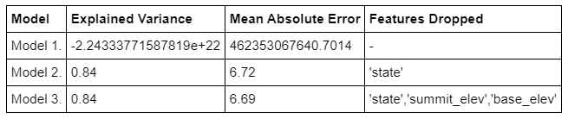
Modeling Results
Model 1: Price prediction model with all features
Model 2: Price prediction model without the ‘state’ feature
Model 3: Price prediction model without the ‘state’, ‘summit_elev’, and ‘base_elev’ features

Slide 5
Summary
By increasing adult weekend price from $81 to $96, Big Mountain Resort can expect $4,500,000 increase in revenue, assuming:
The number of visitors will not be affected by the price change
Among the 350,000 visitors of Big Mountain Resort, 300,000 of them are adults
Each adult visitor visits the resort over the weekend at least one day during the entire season

